Slide 1
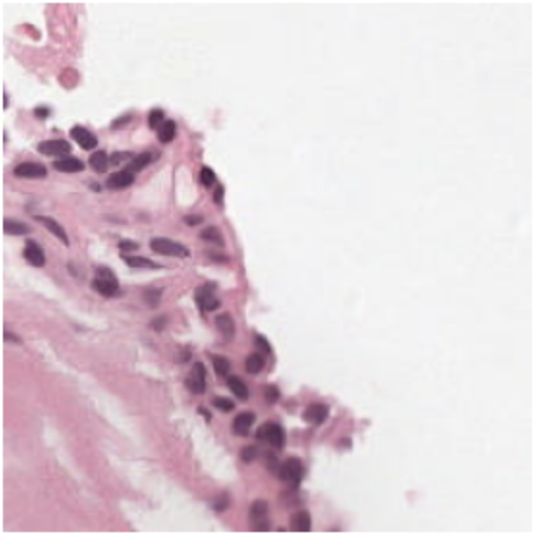
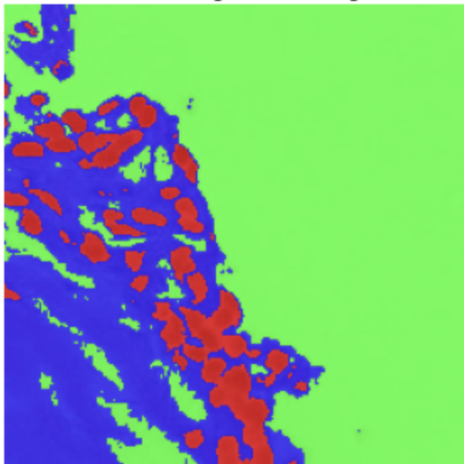
AI Campus Cedars
Team 6 Meeting (Tuesday, June 17): Semantic Segmentation of Prostate Cancer
Biopsy Tissue Using Deep Learning
PANDA (Prostate Cancer Grade Assessment) Challenge
Omar Lab
Department of Computational Biomedicine
Assistant Coaches: Okan Ozdemir and Rish Sharma
June 17, 2025
Semantic Segmentation

Slide 2
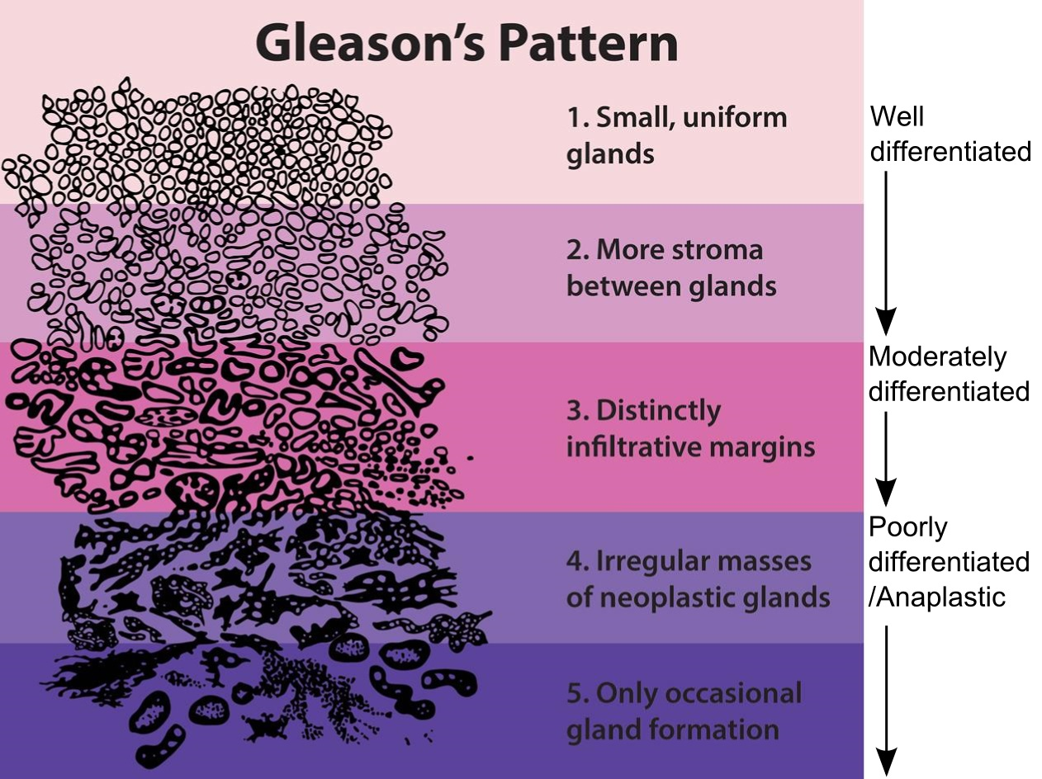
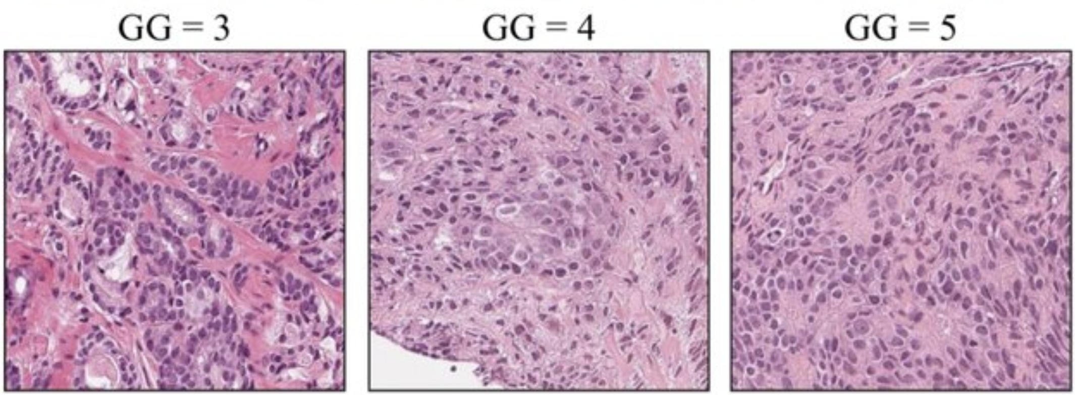
Prostate Cancer & Gleason Grading
The Gleason grading system is used to assess how aggressive the cancer is, based on glandular architecture seen in H&E-stained biopsy tissue. This grade influence treatment decisions: surveillance vs surgery/radiation.

Slide 3
Why Automate Tissue Segmentation?
Manual Gleason grading is time-consuming and subject to interobserver variability, especially between intermediate grades.
Automated segmentation into benign epithelium, stroma, and Gleason patterns will: a) standardize diagnosis, and b) enable large-scale analysis across thousands of cases

Slide 4
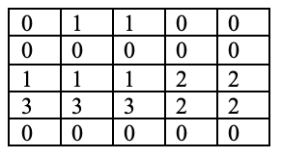
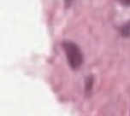
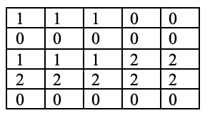
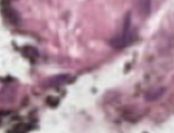
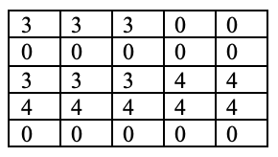
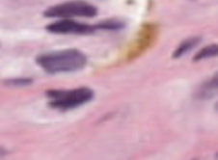
Dataset Overview (Image and Mask Pairs)
0: background (non-tissue) or unknown 1: stroma (connective tissue, non-epithelium tissue) 2: healthy (benign) epithelium 3: cancerous epithelium (Gleason 3) 4: cancerous epithelium (Gleason 4) 5: cancerous epithelium (Gleason 5)

Slide 5

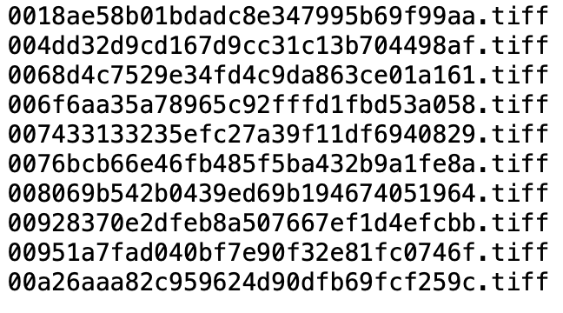
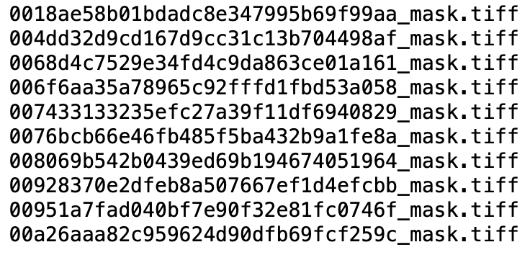
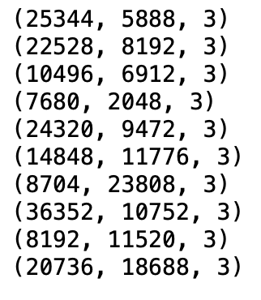
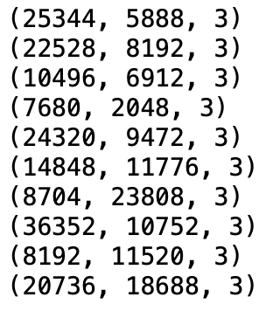
(Recap of Last Meetings) Module 1: Loading of Slide-Mask Pairs
Coupled image and mask files dataset
Matched dimensions

Slide 6
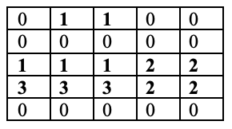

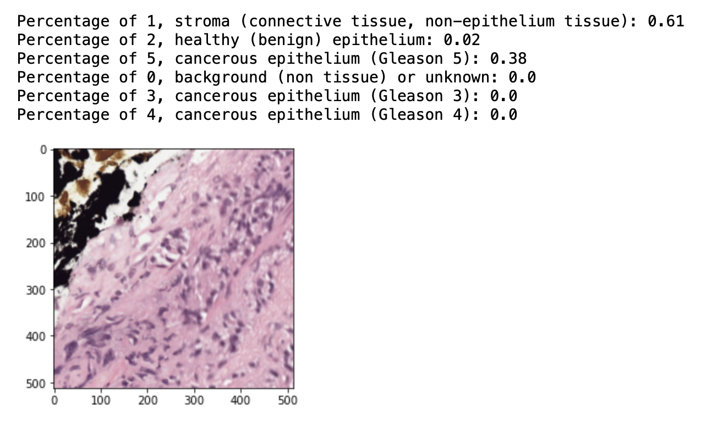
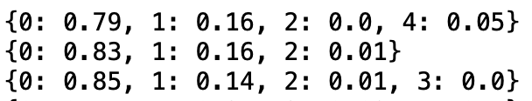
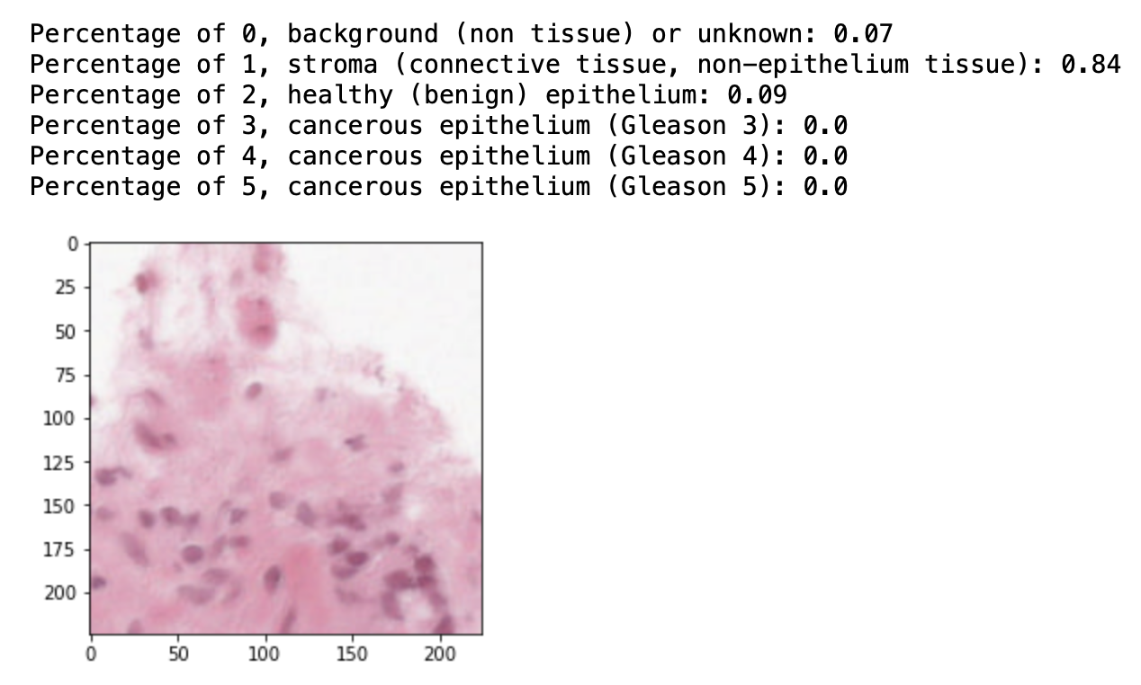
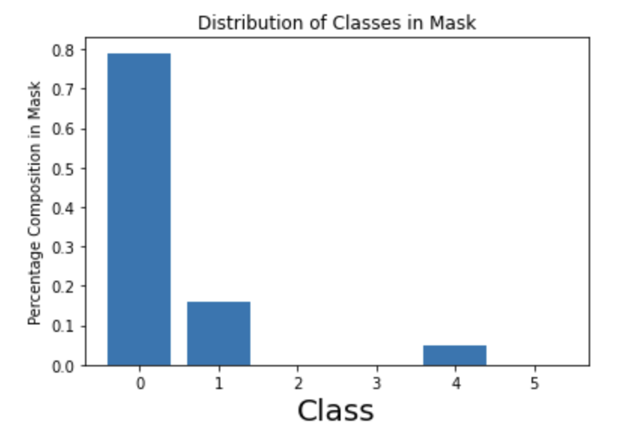
(Recap of Last Meetings) Module 2: Data Visualization and Exploratory Data Analysis
Summary of signal to background ratios in masks
Tile-wise plots by distribution of classes
Summary of class presence in masks
Summary of class distributions in masks

Slide 7
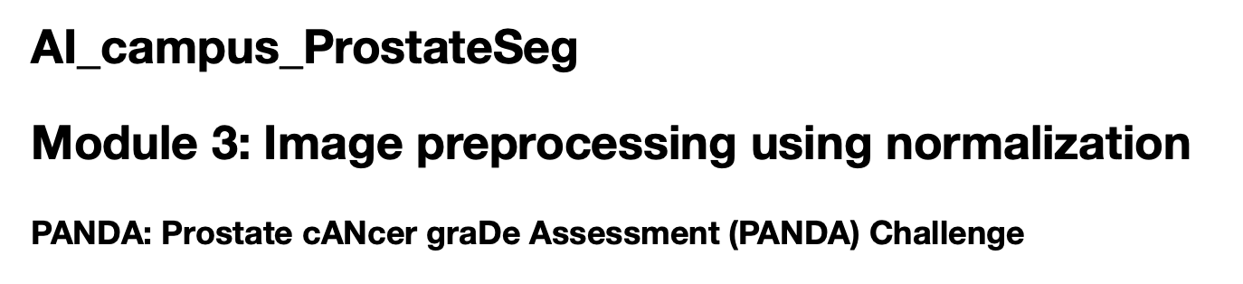
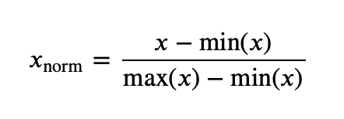
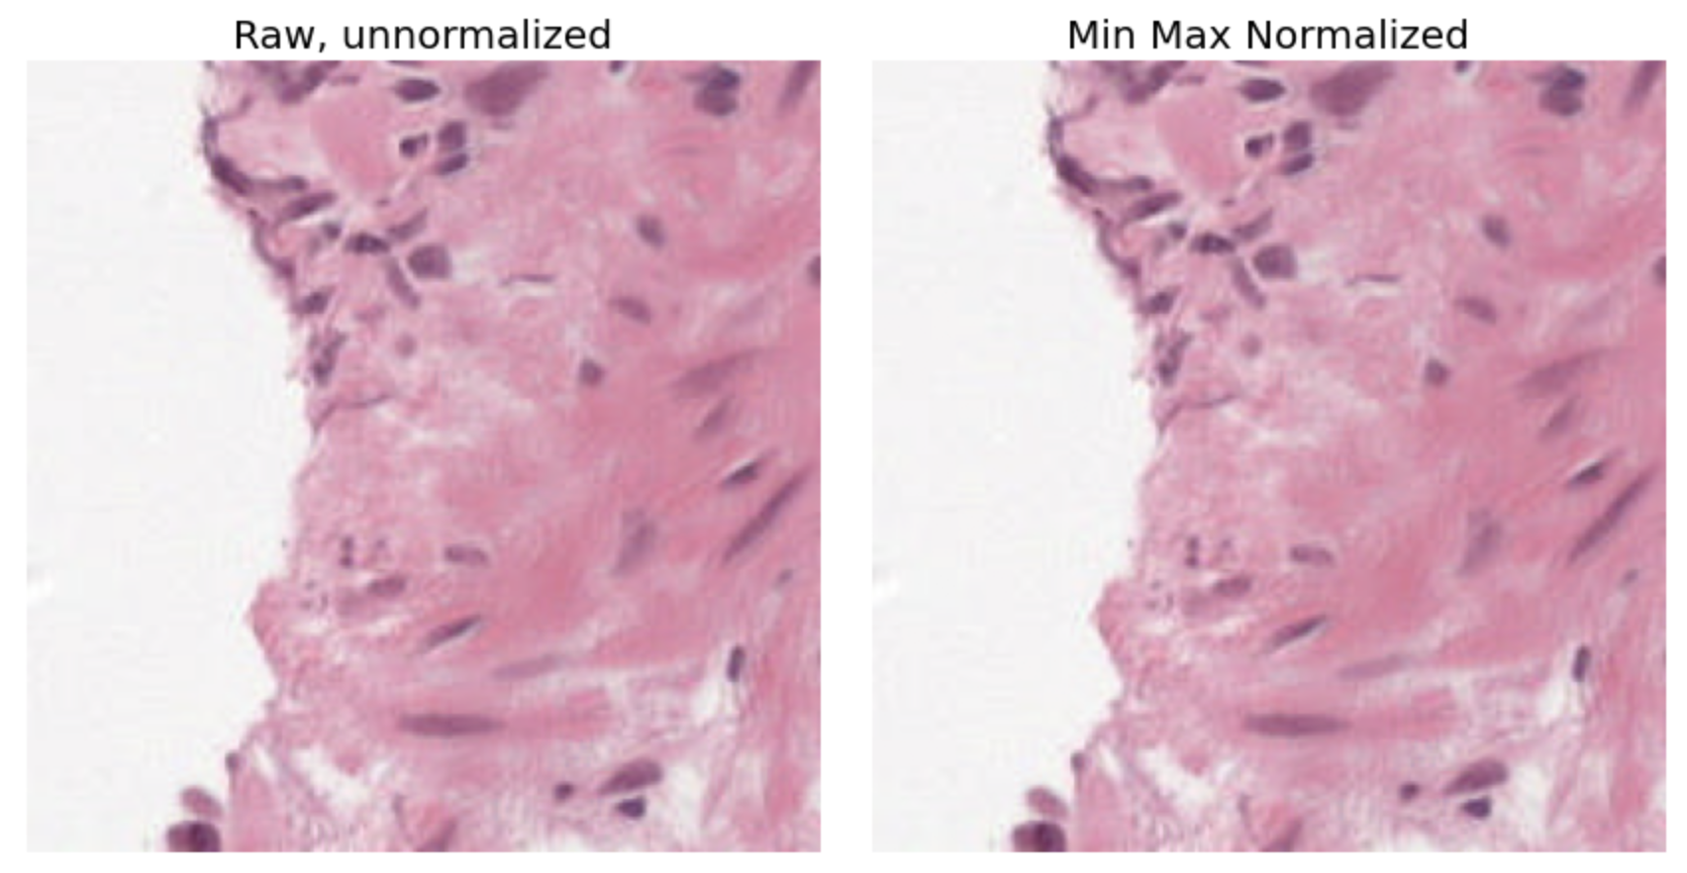
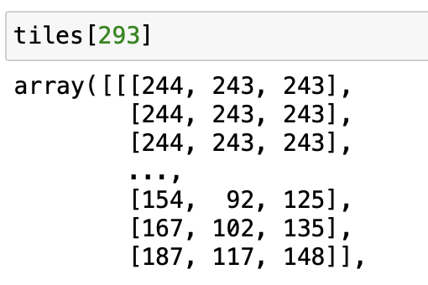
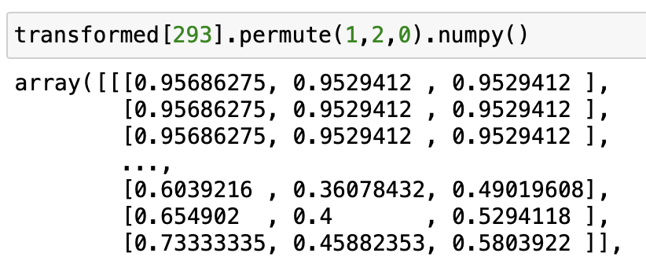
(Recap of Last Meetings) Module 3: Image Pre-Preprocessing Using Normalization
Min-max normalization
Channel-wise normalization

Slide 8
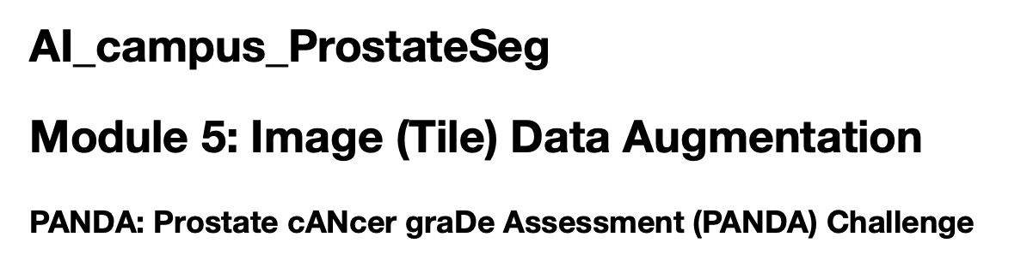
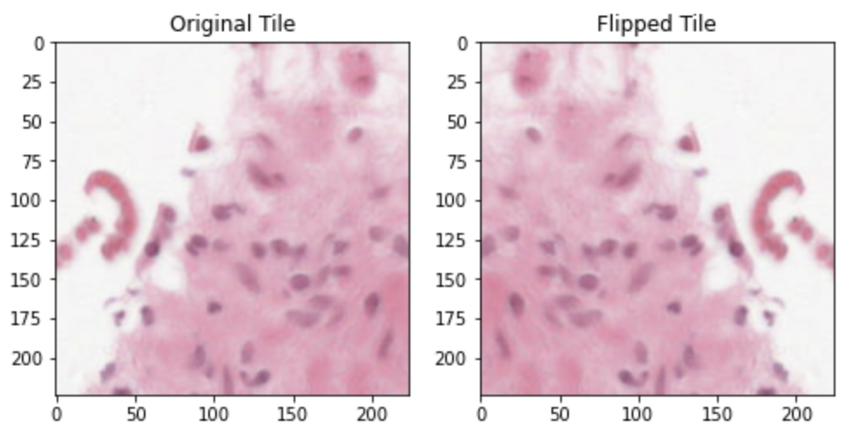
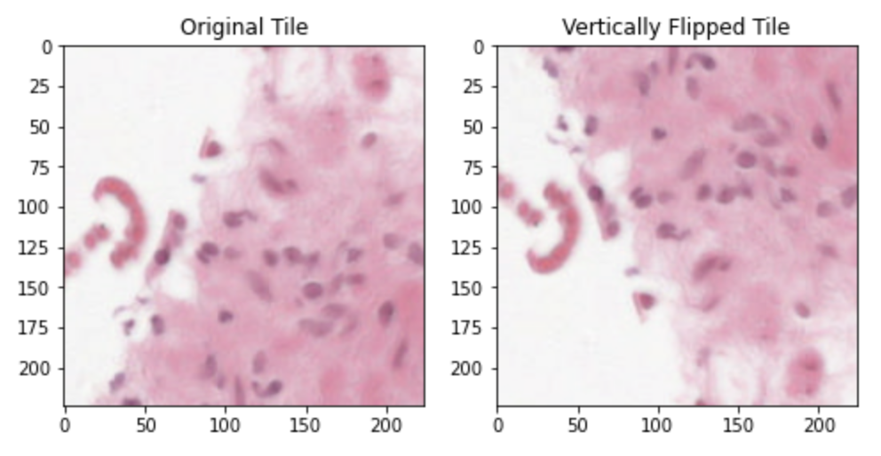
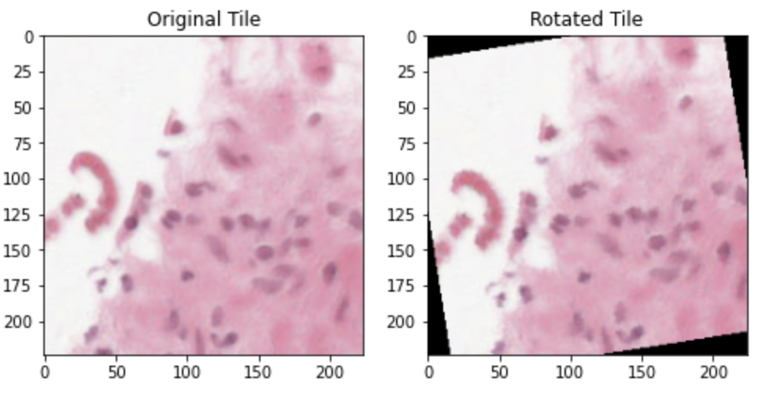
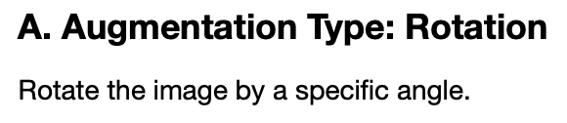
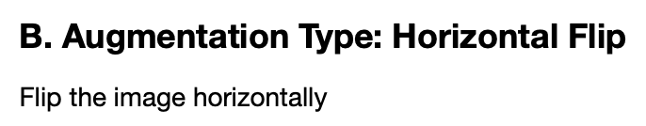
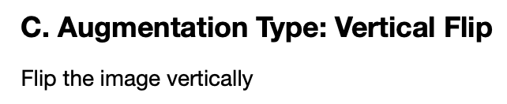
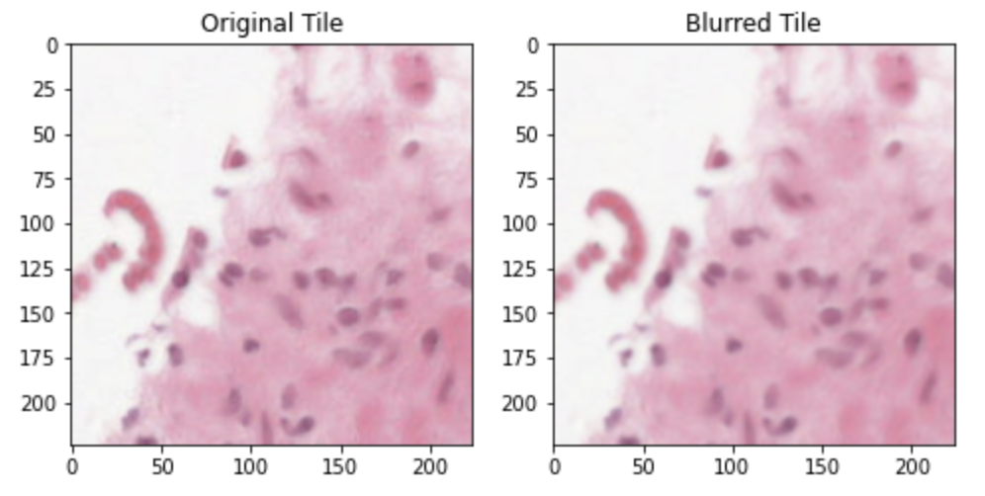
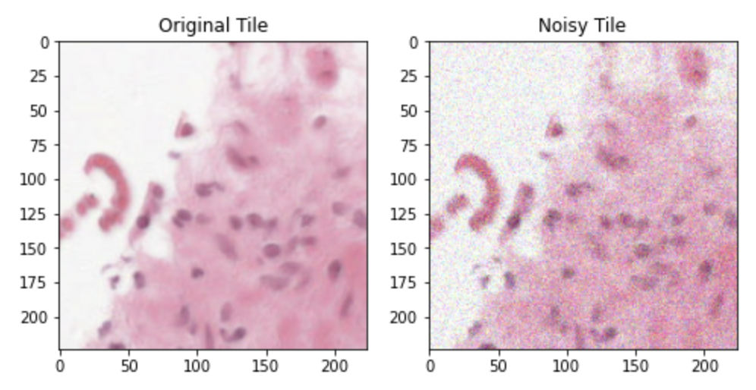
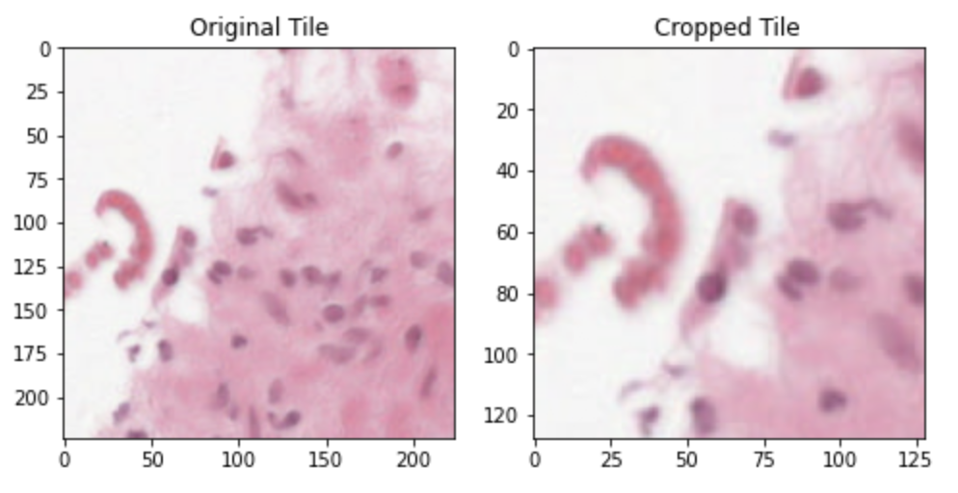
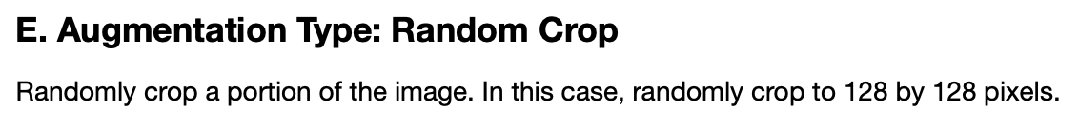
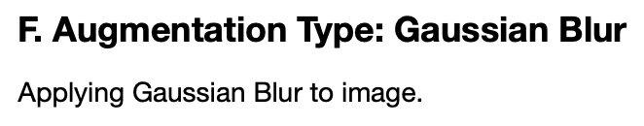
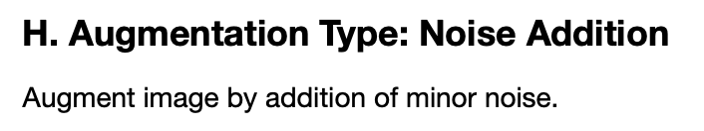
(Recap of Last Meetings) Module 5: Image (Tile) Data Augmentation

Slide 9
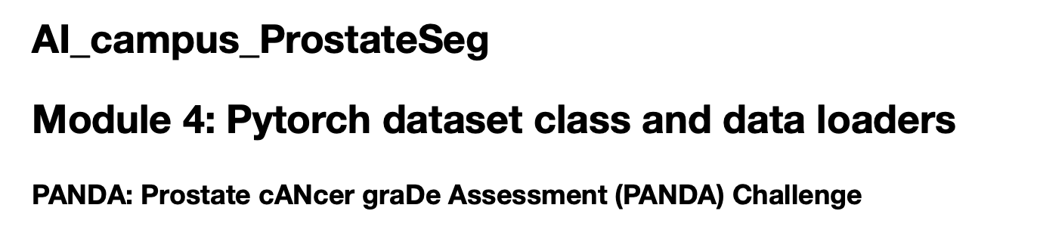
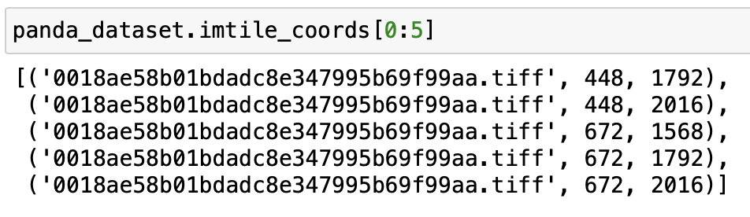
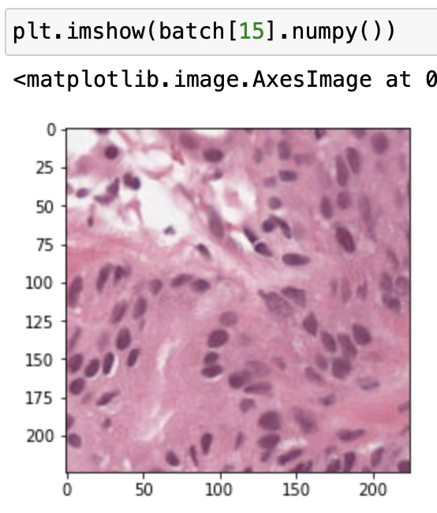
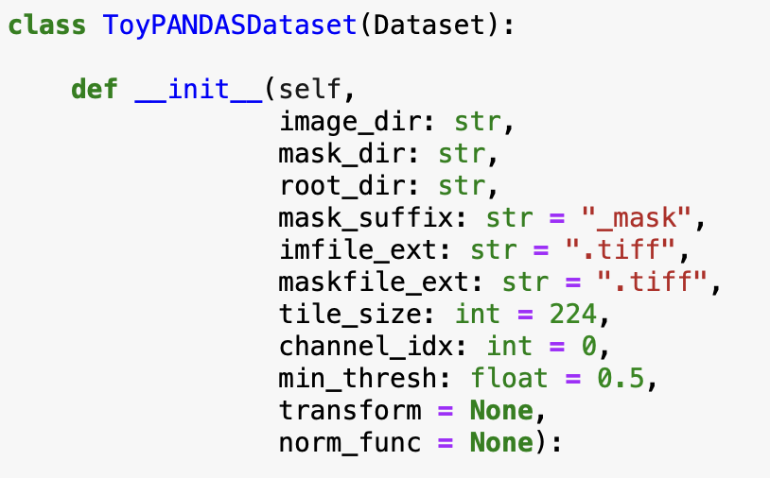
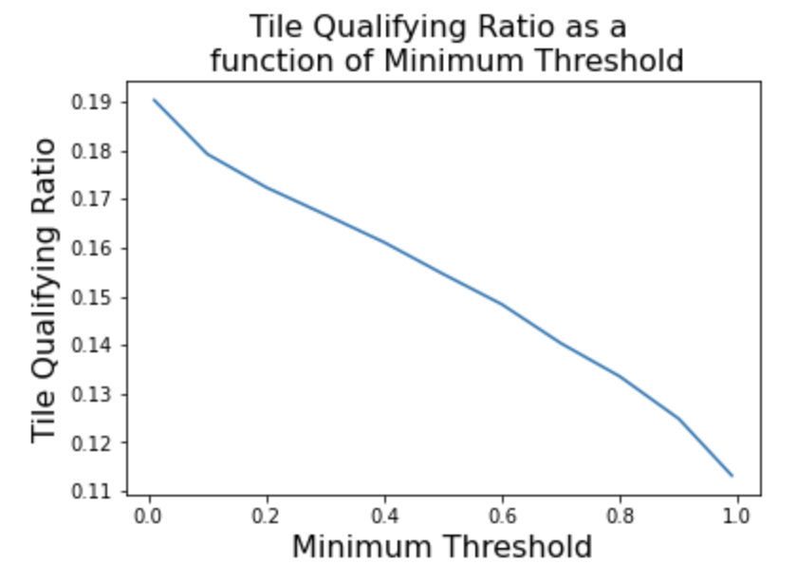
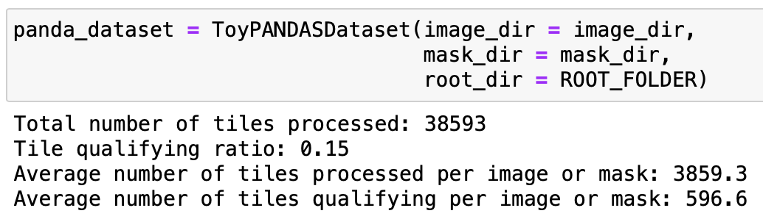
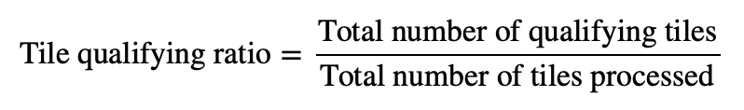
(Recap of Last Meetings) Module 4: PyTorch Dataset Class and Data Loaders
Dataset class iterates over image tiles, tuple contains image file and tile coordinates
Example tile
Custom dataset class
Tile-wise processing of PANDA dataset images

Slide 10
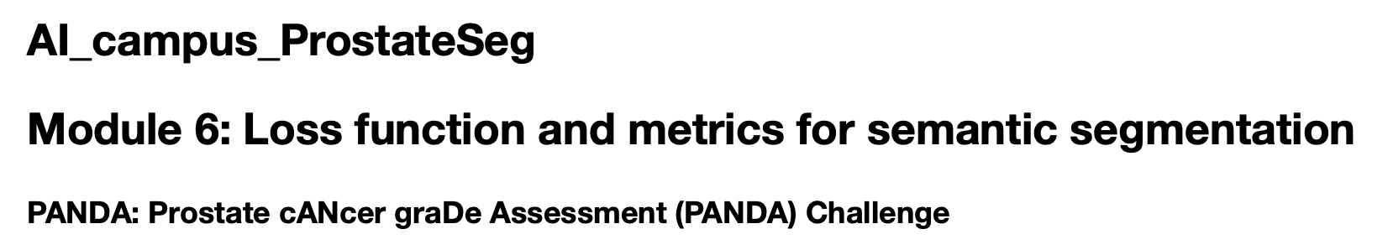
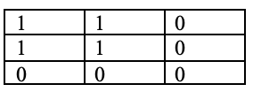
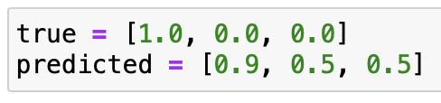
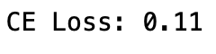
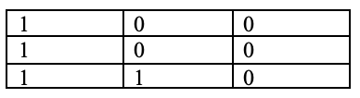
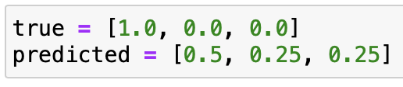







(Recap of Last Meetings) Module 6: Loss Function and Metrics for Semantic Segmentation
IOU=1.0
Ground truth mask
Predicted mask
IOU=0.33
Ground truth mask
Predicted mask
IOU=0.00
Ground truth mask
Predicted mask
Intersection over Union between ground truth and predicted mask pairs

Slide 11




(Recap of Last Meetings) Module 7: Unsupervised Image Segmentation Using K-means clustering
Pixel → 3D [R,G,B] vector
2-dimensional

Slide 12



(Recap of Last Meetings) Module 8: Unsupervised Image Segmentation Using DBSCAN
Pixel → 3D [R,G,B] vector

Slide 13



(Recap of Last Meetings) Module 9: Unsupervised Image Segmentation Using Mean Shift
Pixel → 3D [R,G,B] vector

Slide 14



(Recap of Last Meetings) Module 10: Image Segmentation Using SoftMax Classifier
Pixel → 3D [R,G,B] vector

Slide 15




(Recap of Last Meetings) Module 11: Image Segmentation Using U-Net

Slide 16


(Recap of Last Meetings) Module 12: Hyper-Parameter Tuning of U-Net Prototype

Slide 17
(Agenda for Today’s Meeting): Campus Showcase Presentation Discussion (July 9)
Topic | Description | Presenter
Introduction of problem/dataset and research question | Gleason grading, automation, minimizing inter-observer variability | Mohamed/Rishabh/Okan
Methods Discussion 1: Image Pre-processing, augmentation | Normalization formula and motivation, examples of normalized and unnormalized tiles, original and augmented tiles, signal ratio-based tile loader | Ghazal
Methods Discussion 2: Unsupervised image segmentation using k-means, DBSCAN, mean-shift | Schematic of K-means, DBSCAN, mean-shift, steps involved. Image pre-processing for clustering application via RGB vector conversion | Ghazal
Methods Discussion 3: Supervised image clustering using SoftMax classifier, U-Net | Schematic of SoftMax classifier neural network, RGB vector conversion for classifier input featurization, Schematic of U-Net, layers, architecture, hyper-parameters, output segmentation mask structure (distribution over classes, argmax, etc for producing segmentation mask) | Rongsen Li
Results Discussion 1: Unsupervised image clustering results from k-means, DBSCAN, and mean-shift | Examples of segmented images from k-means, DBSCAN and mean-shift, comparative summary of strengths and weaknesses, applicability, rank algorithms based on clustering quality | Agnes
Results Discussion 2: Supervised clustering results from SoftMax classifier and U-Net | Examples of segmented images from SoftMax classifier and U-Net, differences from each other and from unsupervised methods | Rongsen Li
Future work (closing remarks) | Model hyper-parameter tuning, tiling approaches | Mohamed
Conclusion (closing remarks) | Comparison b/w unsupervised/supervised methods | Mohamed
Time per team: 10 min + 5 for Q/A (15 min total)
Maximum of 10 to 15 slides
Recommended format:
Introduction of problem/dataset and research questions
Discussion of methods
Discussion of results
Discussion of conclusions and possible future work
Participants List
Neenah Huang
Jihyeon Lee
Rongsen Li
Agnes Lo
Ghazal
1-2 slides per team member

